Slide 1
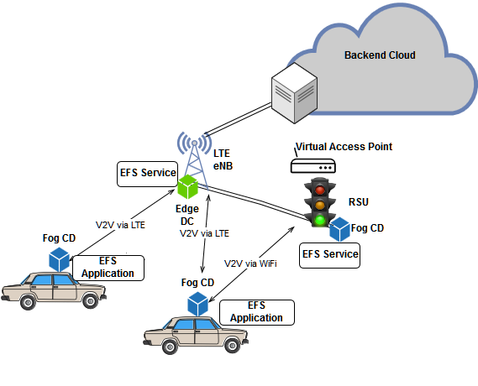
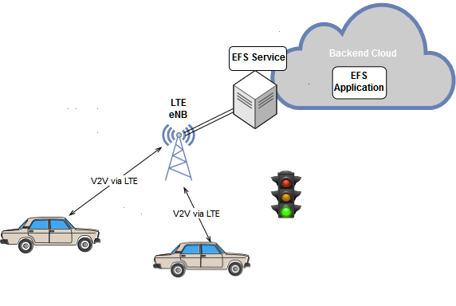
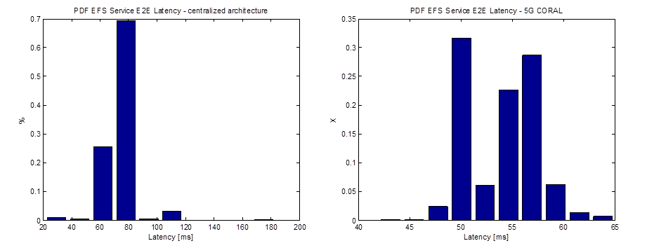
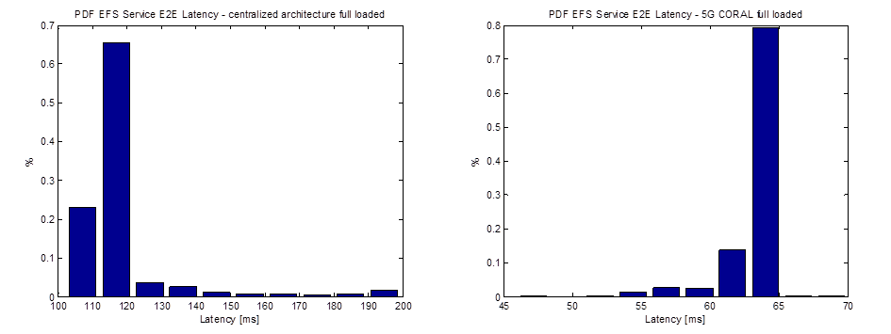
5G-CORAL:Connected Cars
Legacy centralized architecture
5G CORAL architecture
In the legacy centralized architecture, services and applications are placed beyond the core network.
The 5G CORAL architecture spans over both edge data centers, i.e. MEC servers near the eNB, and fog computing devices, such as On Board Units (OBUs) and Road Side Units (RSUs), where applications and services are instantiated. RSUs work also as virtual APs, providing an additional RAT.
Results:
The E2E Latency is measured in two scenarios :
nominal scenario: only OBUs are generating traffic;
stressed scenario: fully loaded LTE cell.
The Probability Density Function is depicted below. In both scenarios, the 5G CORAL architecture guarantees low and stable latency.
Nominal scenario
Stressed scenario

