Slide 1
Arbitration in the Vertical Slicer
Claudio Casetti
Politecnico di Torino
RAN World 2018
Roma, Oct. 10, 2018

Slide 2
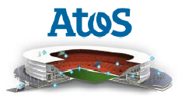
5GTransformer Overview
Vision: Mobile Transport Networks shall transform from today’s rigid interconnection solutions into an SDN/NFV-based 5G Mobile Transport and Computing Platform supporting diverse vertical industries.
Technical Approach: bring “Network Slicing” into mobile transport networks by provisioning and managing slices tailored to the needs of verticals.
Enable Vertical Industries to meet their service requirements within customized network slices;
Aggregate and Federate transport networking and computing fabric, from the edge up to the core and cloud, to create and manage slices throughout a federated virtualized infrastructure.
Automotive
Healthcare
Media
M(V)NO

Slide 3
5GT Architecture
Three-layer architecture:
5GT-MTP: manages physical infrastructure (access and transport domains)
5GT-SO
5GT-VS: Vertical Slicer
Vertical / MVNO
Vertical / MVNO
OSS/ BSS
OSS/ BSS
5GT-VS Vertical Slicer
5GT-VS Vertical Slicer
Network Slice Manager
Network Slice Manager
5GT-SO Service Orchestrator
So-So Federation
5GT-SO Service Orchestrator
5GT-MTP Mobile Transport and Computing Platform
5GT-MTP Mobile Transport and Computing Platform
Notes:
Mobile Transport and Computing
Platform (5GT-MTP) manages a physical infrastructure composed of multi-technology network resources, spanning from the radio to the (possibly integrated) fronthaul and backhaul, access
Infrastructure resources are virtualized and abstracted by the 5G-MTP to allow the instantiation of Virtual Network Functions (VNFs) and NFV Network
Services (NFV-NSs), orchestrated by the Service Orchestrator (5GT-SO)
Vertical Slicer (5GT-VS) offers a vertical-oriented perspective, where vertical
services are requested and deployed based on business requirements (e.g. in terms of required functionalities, service constraints and parameters), delegating the infrastructure and resource related decisions to the lower layers. The 5GT-VS translates a service specification into the corresponding resource requirements and
instantiates network slices satisfying the requirements, complying with the SLAs of the vertical.

Slide 4
5GT Architecture
Three-layer architecture: 5GT-VS
requests and deploys services for Verticals
translates a service specification into resource requirements and instantiates network slices satisfying the requirements
delegates to lower layers decisions on infrastructure and resources
Vertical service requests are mapped onto Network Service Descriptors
Vertical / MVNO
Vertical / MVNO
OSS/ BSS
OSS/ BSS
5GT-VS Vertical Slicer
5GT-VS Vertical Slicer
Network Slice Manager
Network Slice Manager
5GT-SO Service Orchestrator
So-So Federation
5GT-SO Service Orchestrator
5GT-MTP Mobile Transport and Computing Platform
5GT-MTP Mobile Transport and Computing Platform

Slide 5
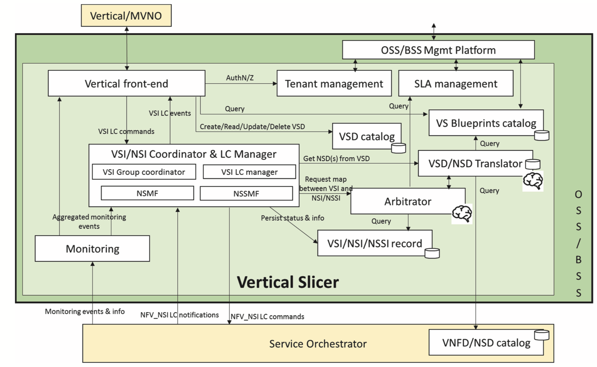
Vertical Slicer Architecture
Notes:
The three main components are:
(i) the Vertical Service Instance/Network Slice Instance coordinator and lifecycle manager handles the delivery and runtime of vertical services, coordinating their lifecycle with suitable actions at the
corresponding NSI and network slice subnet instances (NSSI)
(ii) VSD/NSD translator handles the translation
between vertical service descriptors (VSD) and NSDs,
allowing to shift from the business oriented perspective
of the verticals to the resource oriented internal view of
the system to deploy the services.
(iii)the Arbitrator regulates how multiple vertical
services get access to a vertical’s resource budget and
takes decisions about how services are mapped to
isolated or shared network slices. Note, the Arbitrator
does not have a complete view of the resources, it has to
work with limited information of the resources that are
available in the infrastructure. It is aware of the SLAs
among the verticals and it can balance the resources
assigning probabilities to the services to be deployed
based on the SLAs of the verticals. Eventually,
deployment decisions are made by the 5GT-SO.

Slide 6
VS Arbitrator
Key Feature of VS is the ARBITRATOR whose tasks are:
Deciding how to map new vertical services in NetSlices, allowing multiple vertical services to share one or more.
Determining the Deployment Flavors of each service:
meeting vertical QoS requirements
accounting for service priority level
It solves resource assignment problems

