Slide 1
SD-WAN PoC
Final Demo
Aitor Zabala (TELCA)
Date

Slide 2
Demo Overview
Describe the main feature of your Demo
  PoS Terminal roaming across domains, while PoS service is uninterrupted and QoE maintained.
  Features showcased:
    Validation of static federation mechanism
    Host Mobility service to locate PoS Terminals across domains, by leveraging context information from virtual AP functions.
    Traffic delivery optimization by means of offloading

Slide 3
Demo with/without 5G-CORAL
Describe the benefits added to your demo using 5G-CORAL
  Leveraging 5G-CORAL Federation interface F2
    PoS terminal is able to roam seamlessly across domains.
    Applications can be offloaded closer to the end users (PoS Terminals).
  Use of Host mobility service by leveraging RAT context information
    Allows the PoS service to identify roaming PoS terminals across domains

Slide 4
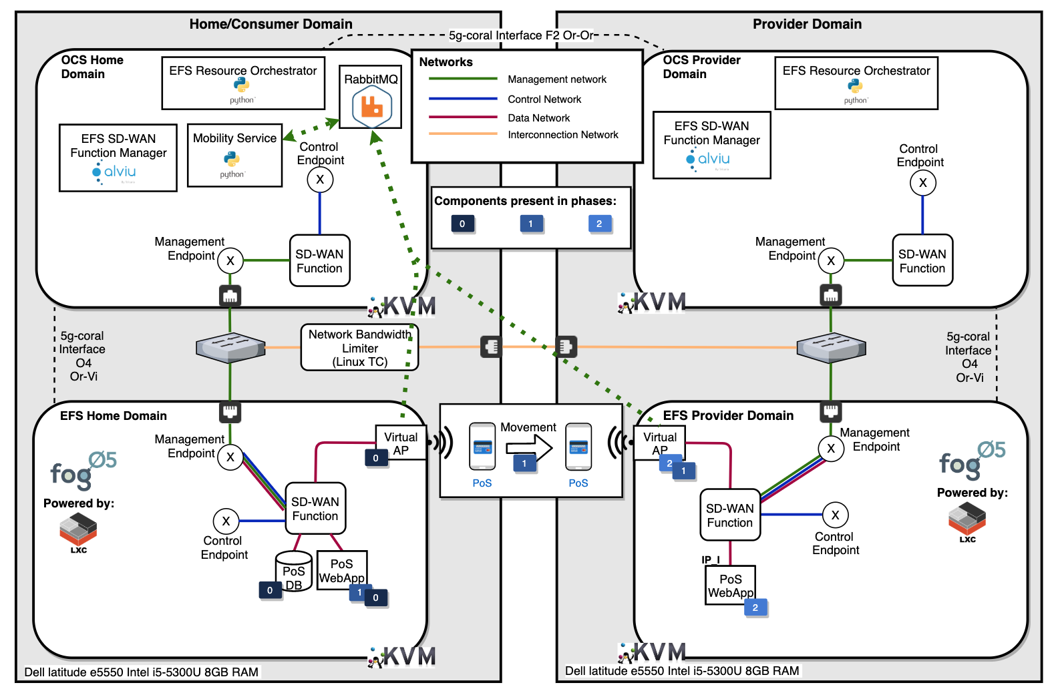
Deployment Layout

Slide 5
Demo Scenario
Host Mobility Service
Describe the demo and how it will be visualized for end-users
  See EUCNC Poster
Virtual Resources
Consumer Domain
Virtual Resources
Provider Domain
Bandwidth Rate Limiter

Slide 6
Development progress
What did you achieve
  Successfully developed and validated a preliminary implementation of the F2 5G-CORAL federation interface.
    Features:
      Sharing resources across domains
      Use the federation interface to provide advanced orchestration mechanisms such as offloading.
  Validation of host mobility service leveraging context information from WIFI RAT.
  PoS Backend functional split in two micro applications:
    PoS Customer & Inventory Database (statically hosted in the home domain)
    PoS Web Application (ability to be replicated as needed)
  Integration of SD-WAN network function/controller/manager into 5G-CORAL ecosystem.
    Added offloading capabilities
    Validated its compatibility with the VIM (fog05)

Slide 7
Results

Slide 8
Next Steps
Integrate Multi-RAT
  Currently WIFI 802.11g/n is demonstrated for both domains
  Options:
    WIFI Direct to connect domains
    Use LTE dongles to connect domains
    Use WIFI 802.11ac as a RAT for one of the domains

Slide 9
How your Demo will tackle 5G-CORAL objectives - I
See next slide

Slide 10
How your Demo will tackle 5G-CORAL objectives - II
Expected impact 1
  Improved latency, bandwidth and jitter by moving applications closer to the user/consumers.
Expected impact 2
  Moving applications closer will allow service providers to serve more end users in the same area due to the increase capacity and reduced latency at the Edge/Fog. Reducing bottlenecks caused when application traffic moves from users terminal to the cloud.
Expected impact 3
  Same contribution as in impact 1, we leverage federation and offloading to move applications closer to end users.
Expected impact 4
  -

