Slide 1
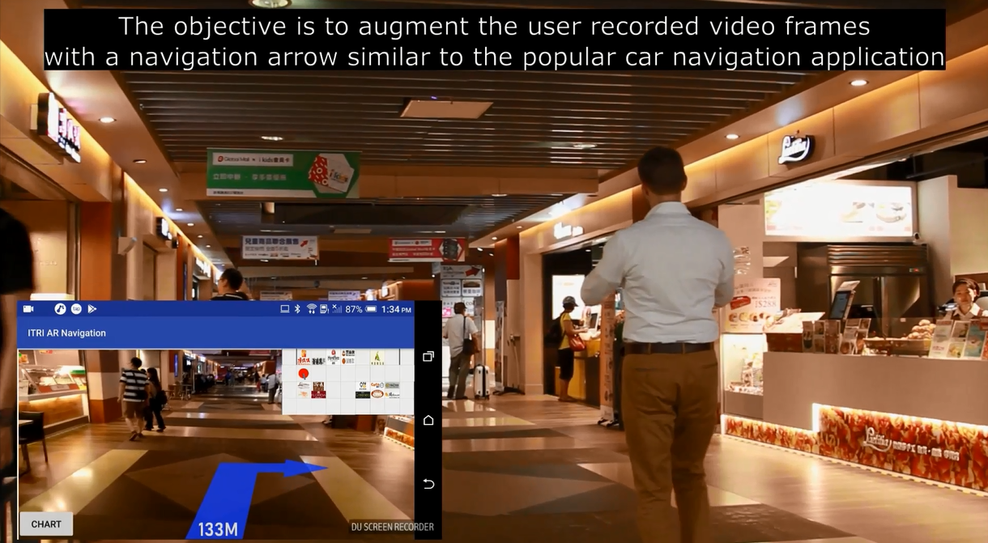
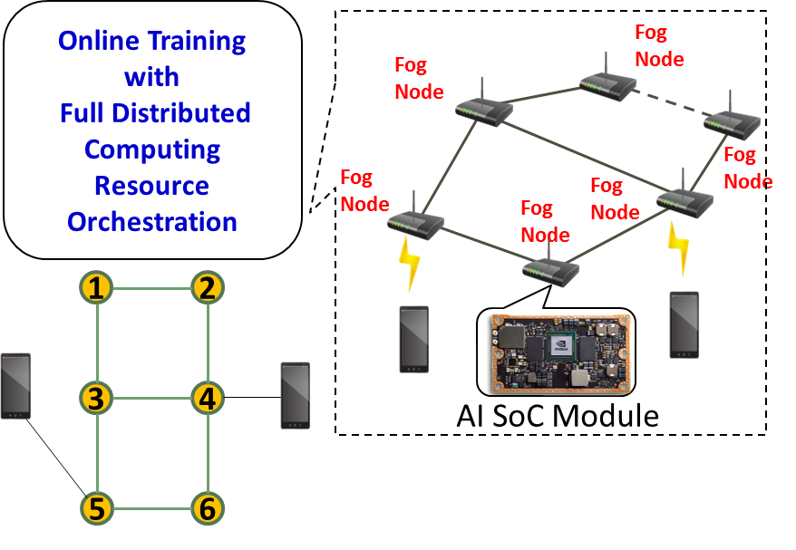
Technology Uniqueness for
Augmented Reality Live Navigation
Advan-
tages
Computation Offloading – Offloads the computation tasks of the end-devices/central cloud to the network edge
Multi-RAT Localization – Locates the user using deployed iBeacon and edge image recognition.
Distributed Computing– Utilizes the distributed nature of the Fog node to offload the load among Fog nodes to facilitate users without affecting the QoS.
KPIs &
Value
Ultra Low Networking Latency
Lower
CAPEX and OPEX
High Duty
Dist. Computing
AI
enabling
Training Data
Machine Learning
Model

